Slide 1


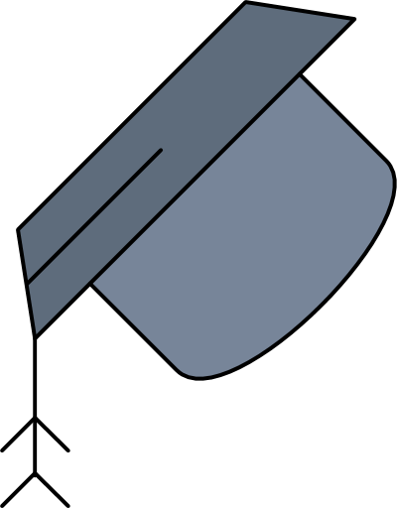





DRDO
RAG
BY : Arjun Pandey
Date:06/08/2024

Slide 2
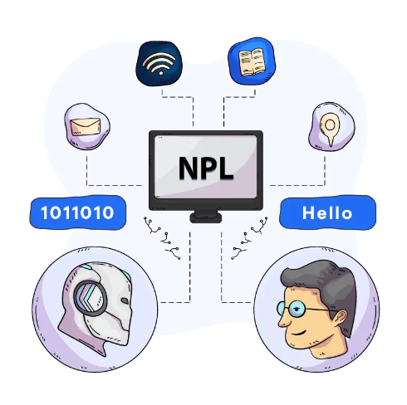


Contents
Introduction LLM
01
02
RAG Overview
Working of rag
03
04
RAG Pipeline

Slide 3
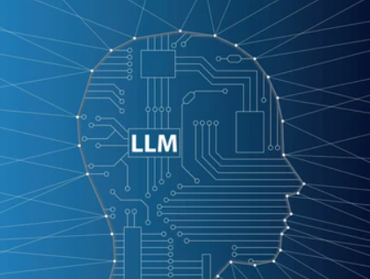
01
LLM
Overview丨Applications丨

Slide 4
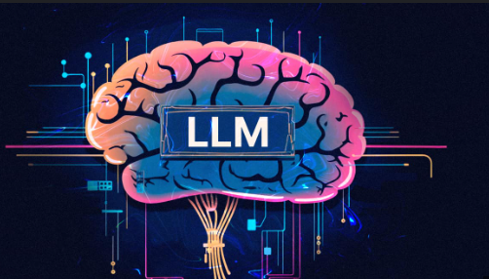


LLMs Overview
Large Language Models
Designed to understand and generate human-like text
Trained on vast amounts of text data
Architectures :The most popular architecture for LLMs
is the transformer.
Examples : Chat-GPT, Google Gemini

Slide 5
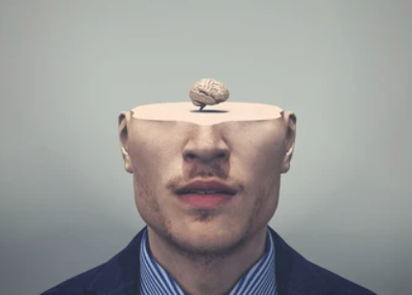
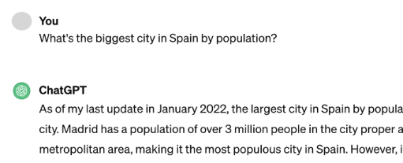
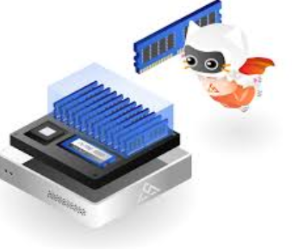
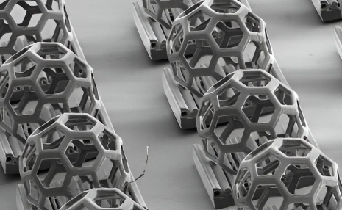
LLMs Limitation
Factual Inaccuracy
Fabricated Answer
Memory and Computation Constraints

Slide 6
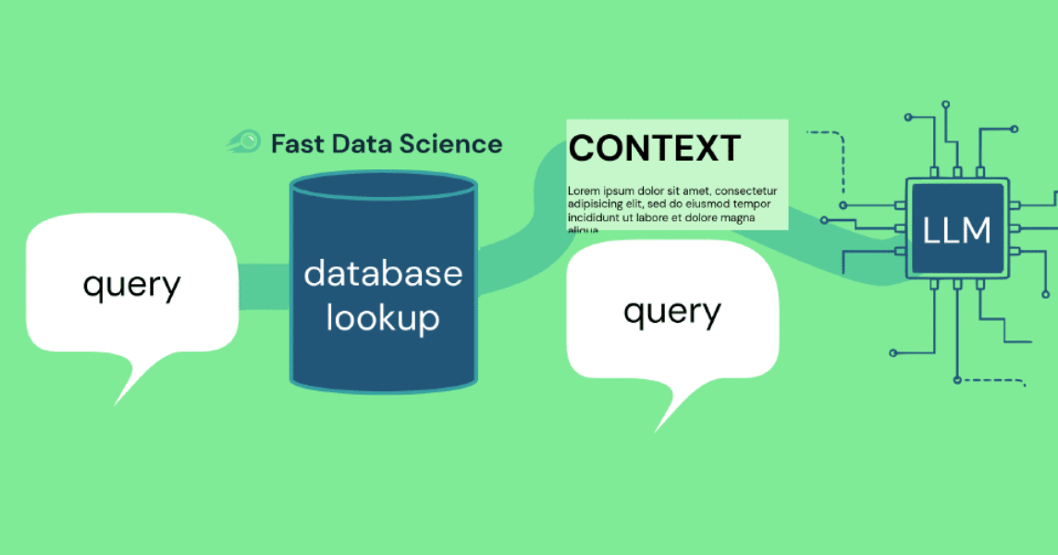
02
Overview of RAG
Overview丨About Us丨Our story丨Problem

Slide 7
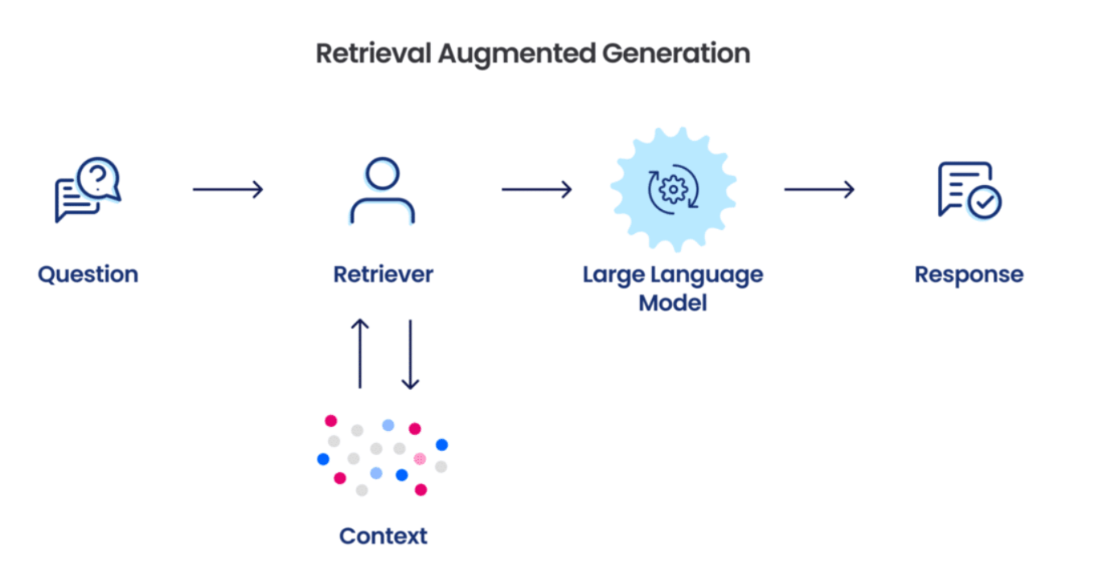

Overview
Retrieval-Augmented Generation
Contextually related information is obtained
Generative language model to
produce a response
based on the retrieved documents
Three Major component
Retrieval Component:
Integration
Generation Component
query + context

Slide 8
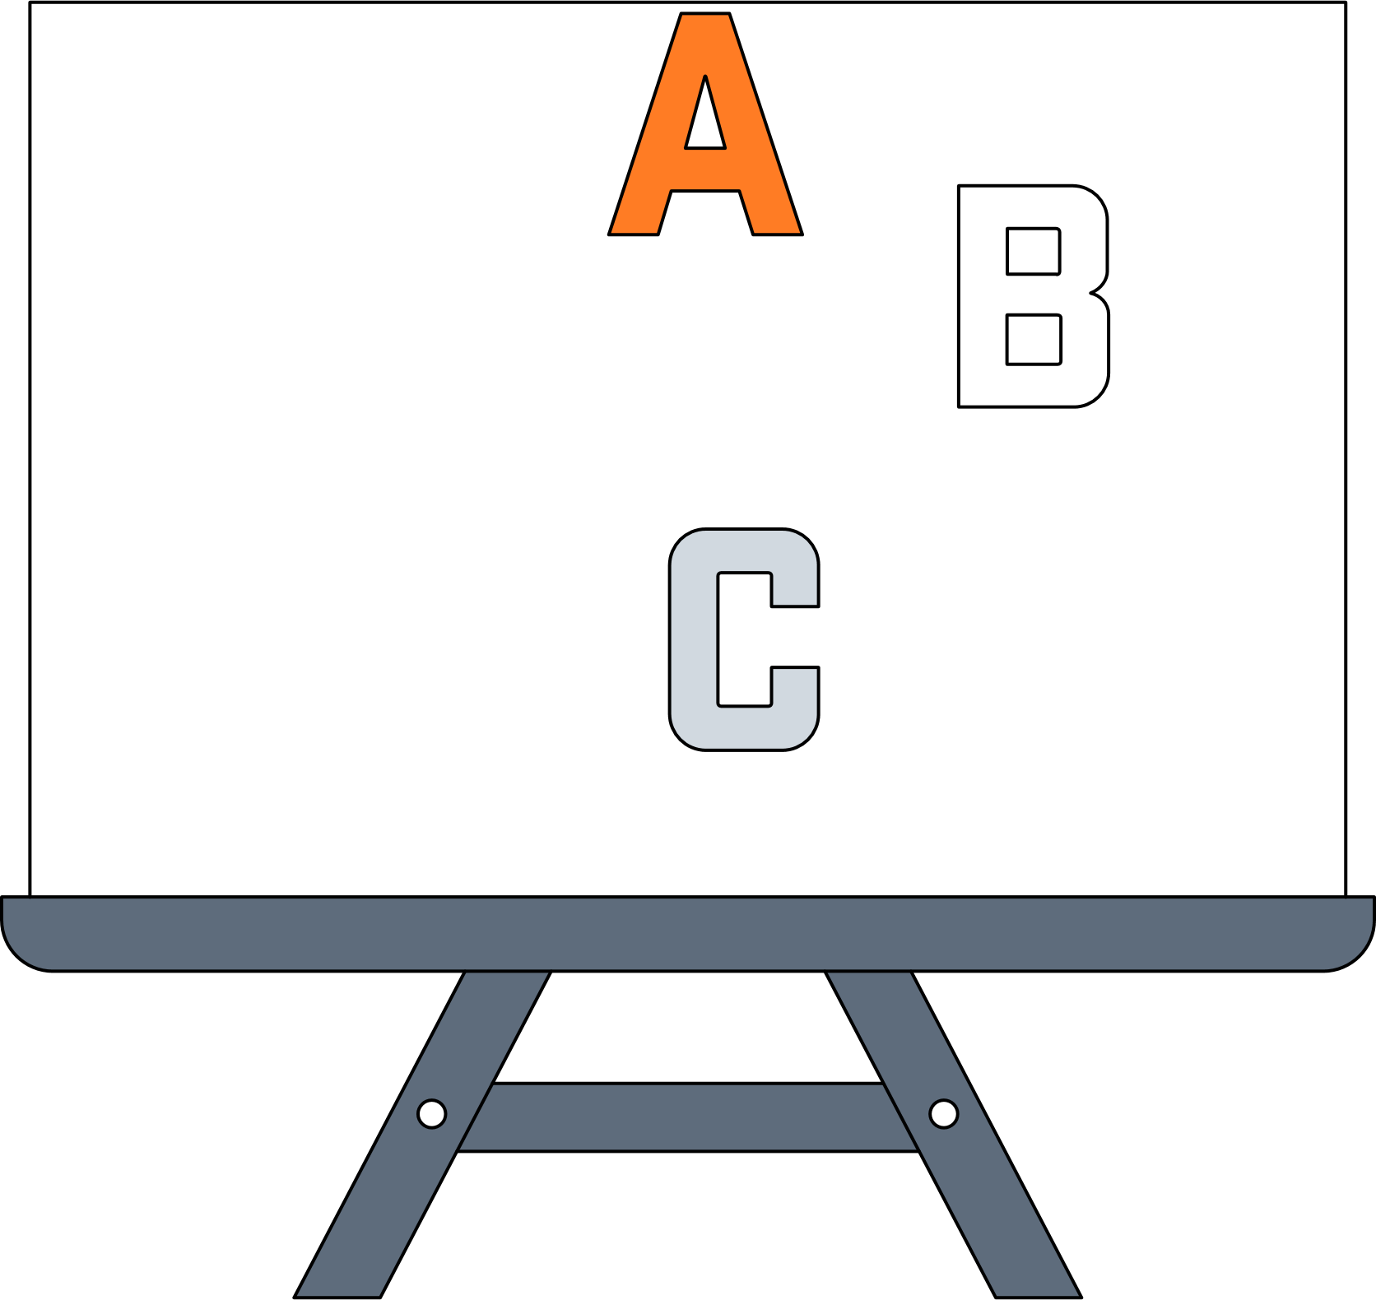

03
Working of rag
Overview丨About Us丨Our story丨Problem

Slide 9
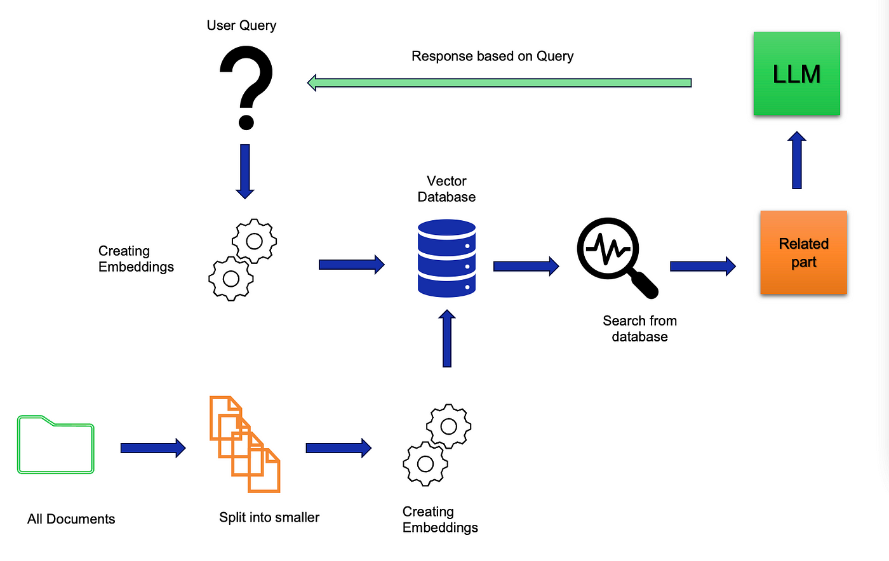
Architecture Overview
query + context

Slide 10
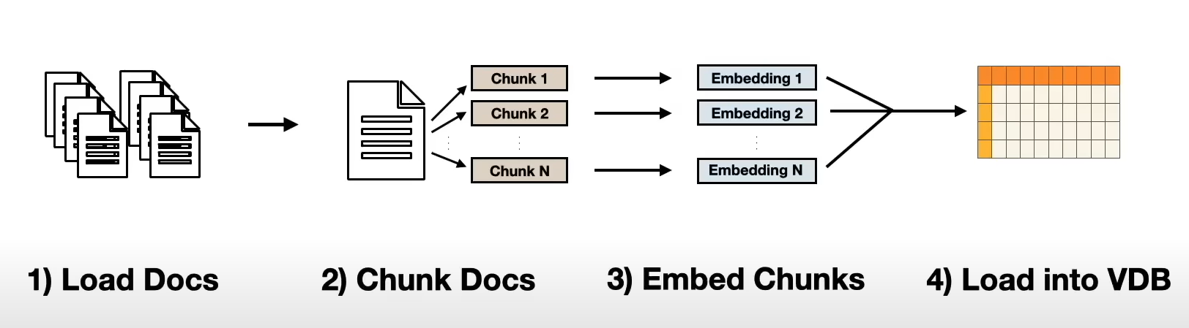
Creating Database (Vector)

Slide 11
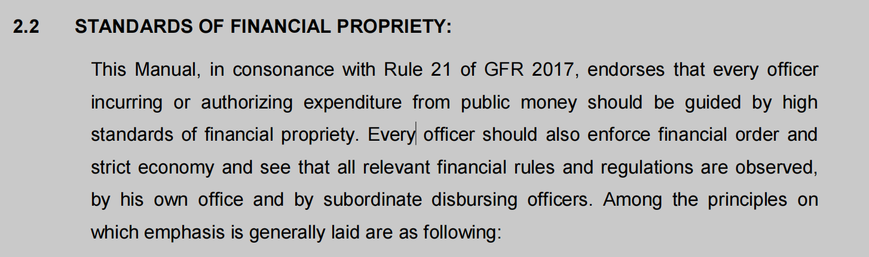
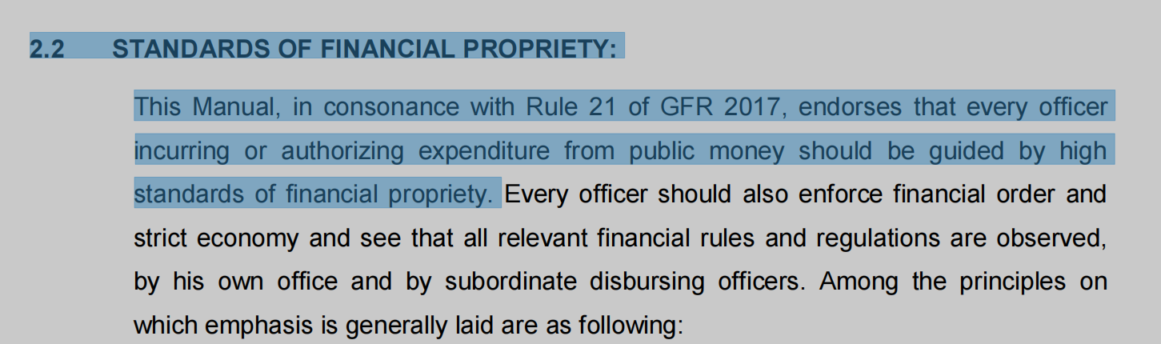
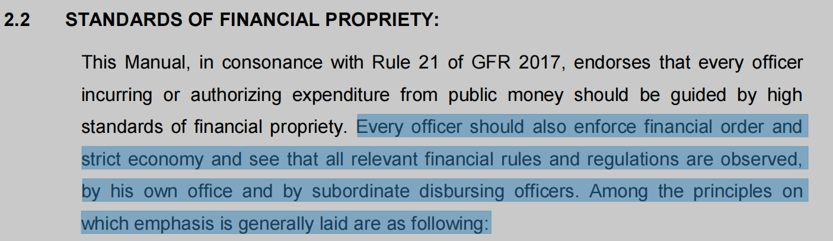
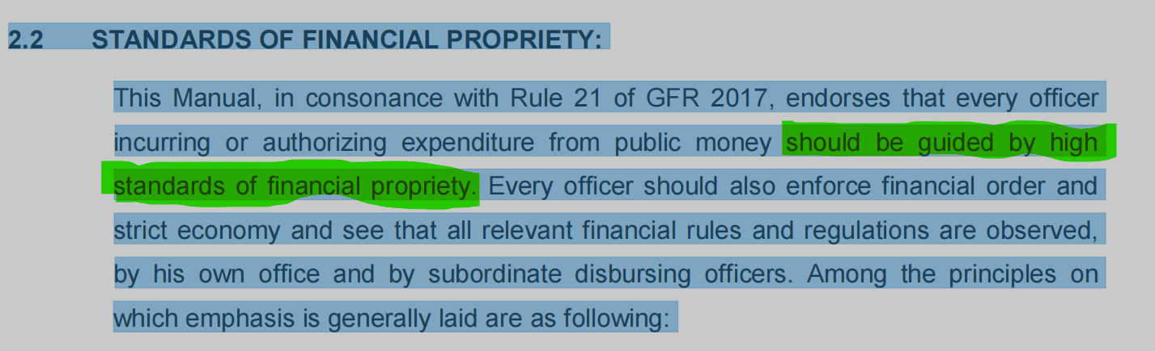

Slide 12
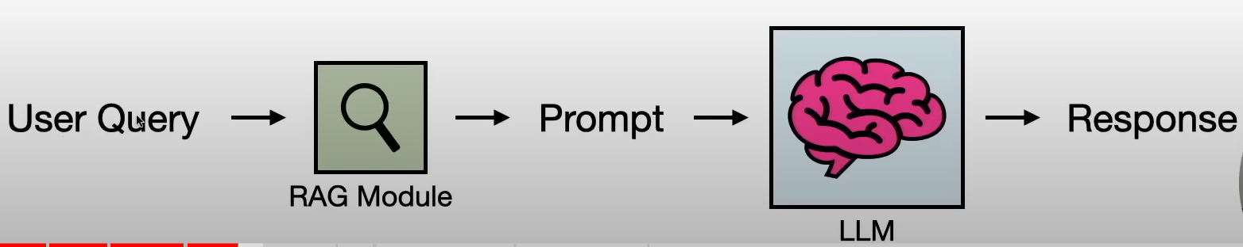
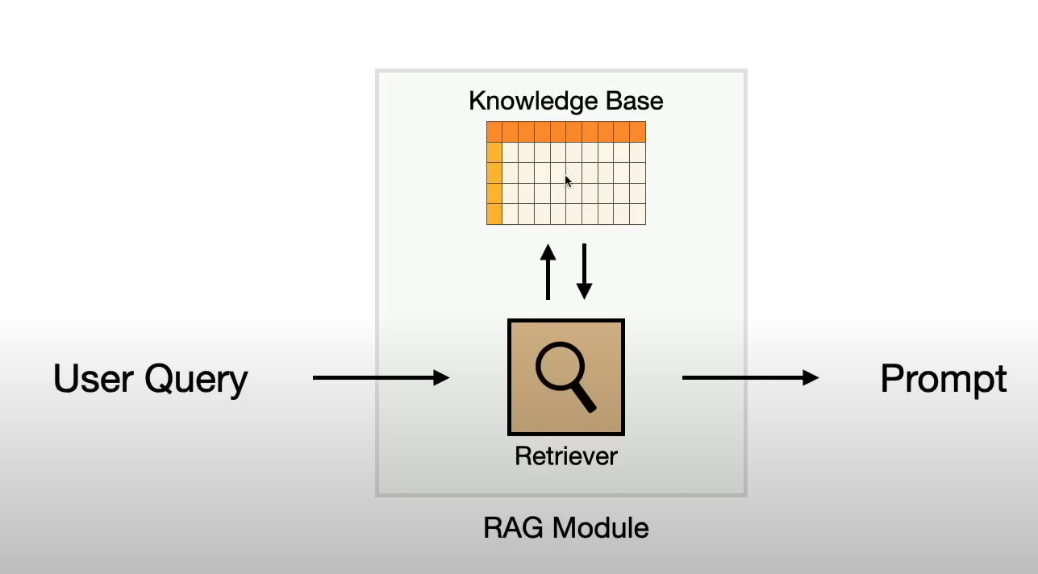
Architecture Detail
query + context

Slide 13
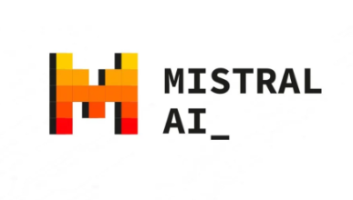
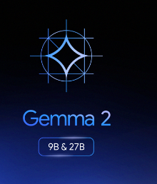
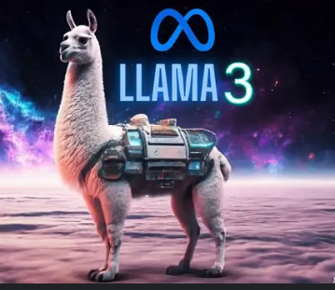
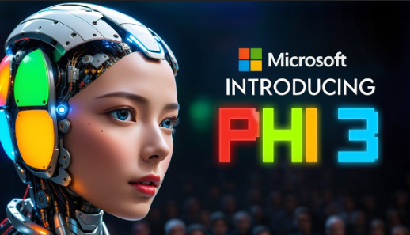
Challenges !!!
Retrieval / Embedding Algorithm
LLM specific / Open Source
LLM input capacity

Slide 14


DYSL-LAB intern
THANKS FOR WATCHING
BY : Arjun Pandey
Date:06/08/2024

